Slide 1
Decontextualized art automata sculptures
Day 3
Miss Greer

Slide 2
In what ways do art and technology coexist with one another in your daily life?

Slide 3
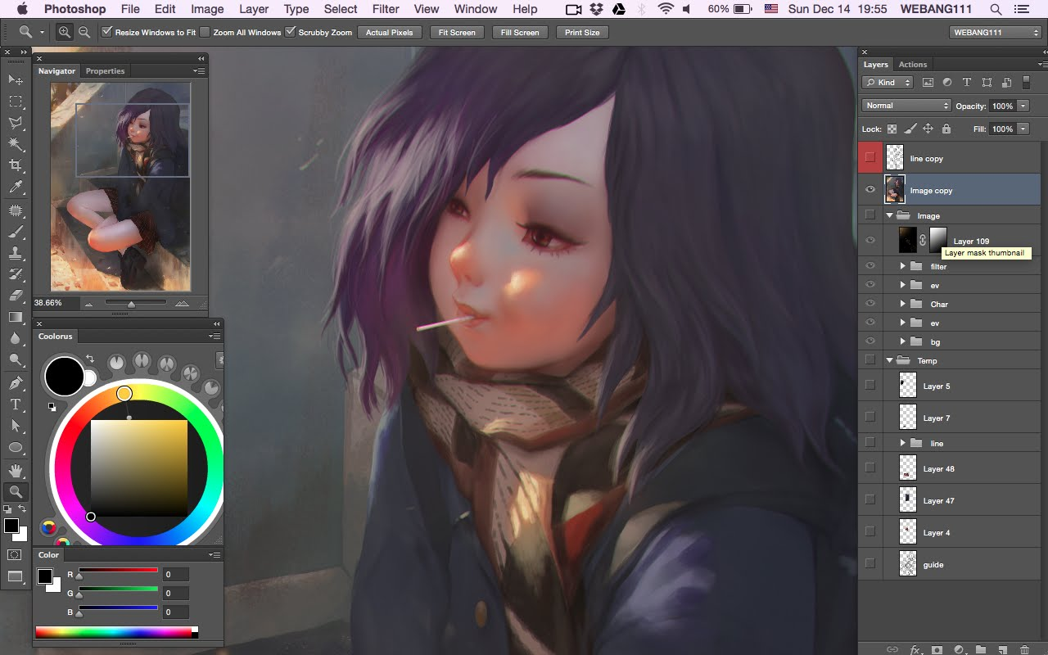
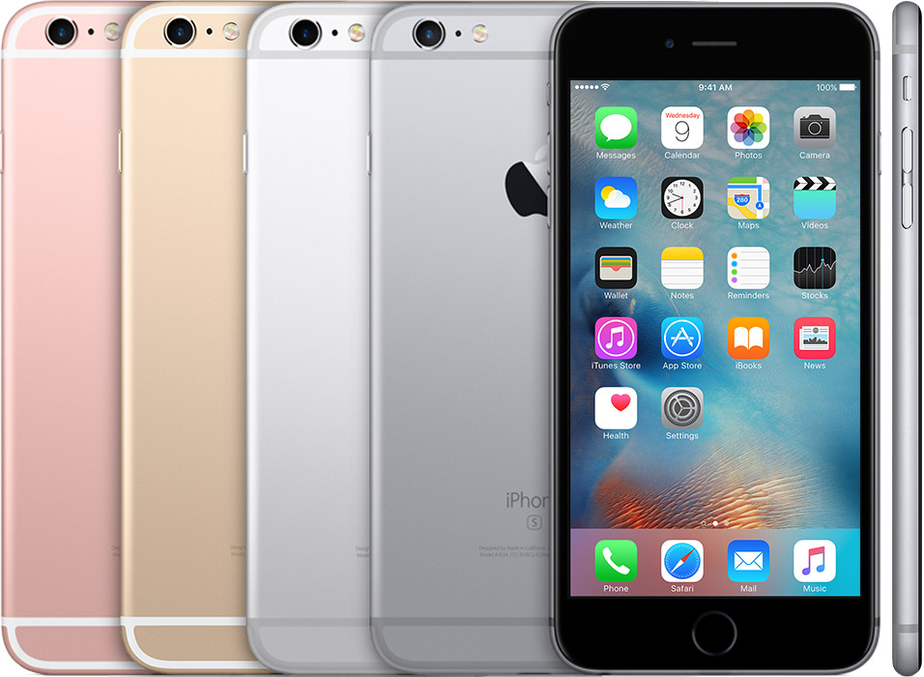
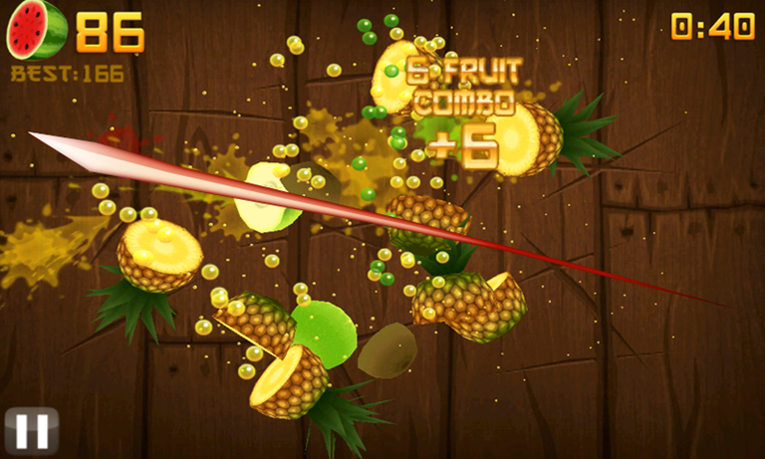
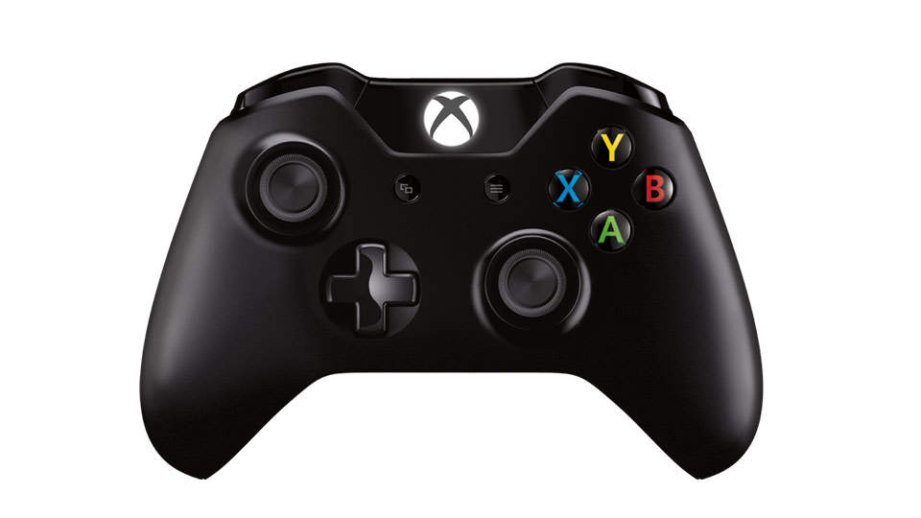

Slide 4
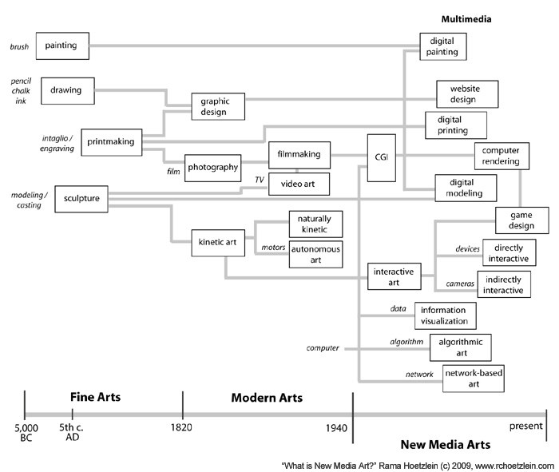
“New Media” Art

Slide 5
Today’s goals: 1: Finish Gluing frame 2: Cut out 4 triangle pieces – begin with two cardboard squares measuring to be 2”x2” – then cut diagonally to create two triangles 3: Demo: building your cam 4: Build your cam 5: Assemble pieces >If time: build Cam Follower
Let’s continue working on our Automata Projects

Slide 6
