Slide 1
Decontextualized Art Automata Sculptures
Decontextualize: consider (something) in isolation from its context, background, or climate
Automata: plural for automaton
Automaton: a mechanical figure constructed to act as if by its own motive power; robot
8th grade
Miss Greer
Title:我爱你，我的龙 (Wǒ ài nǐ, wǒ de lóng)

Slide 2
Artists video: Paul Spooner How does Paul Spooner combine art and technology?

Slide 3
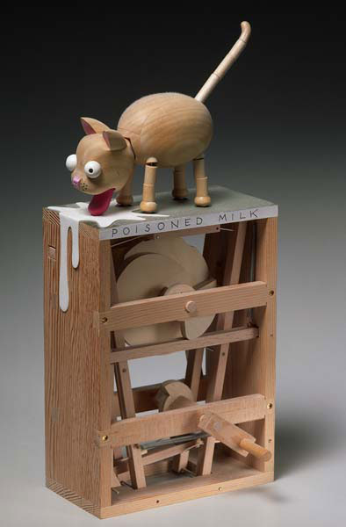
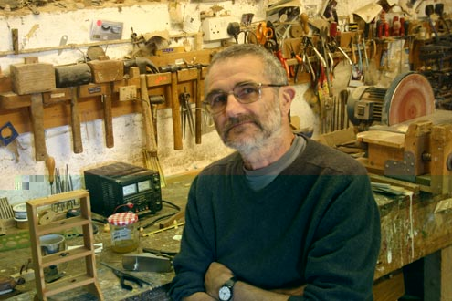
Paul Spooner – Spoiled Milk
What materials does Paul Spooner use?
Who can tell me a problem he has faced as an artist? (hint: video)
What story is he trying to tell in Spoiled Milk?
“I’m a mechanical joke maker…. They are three dimensional cartoons.”

Slide 4
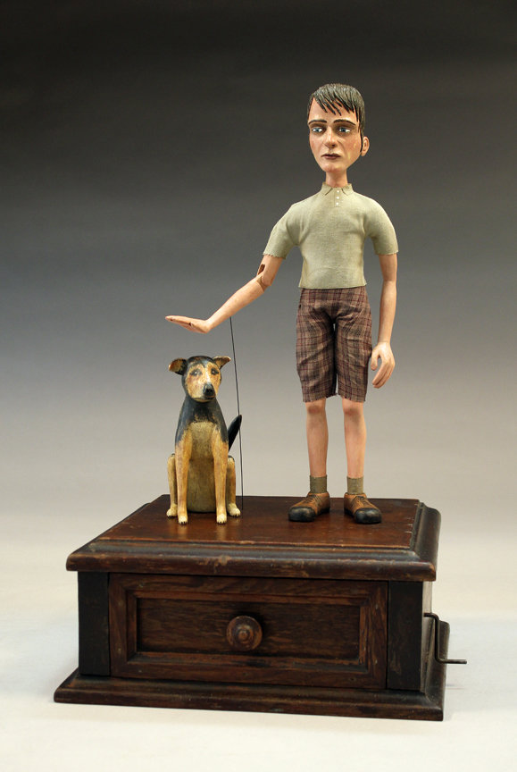
Tom Haney – Trixie and I
An American Artist
He approaches his work “as a way to reconnect with the past” How does he connect to the past in this piece?
Says he is influenced by Pablo Picasso, Leonardo DaVinci, The Wright Brothers, and Thomas Edison
Who can take a guess as to what motion this automaton mimics? How can that movement be generated?

Slide 5
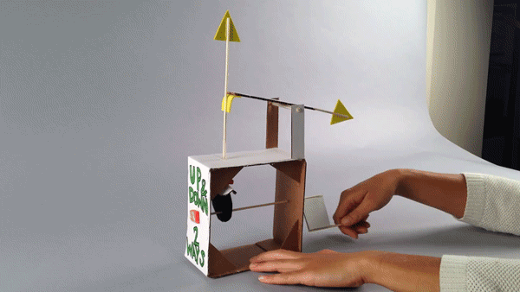
Let’s Tinker with some Automata!
Tinker: the act of experimenting and exploring with new media

Slide 6
Steps for creating a cardboard automata
Functioning Automaton
Visual Planning
Decorate Automaton

Slide 7
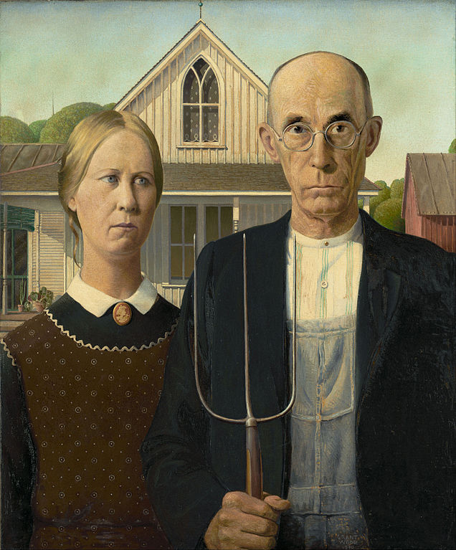
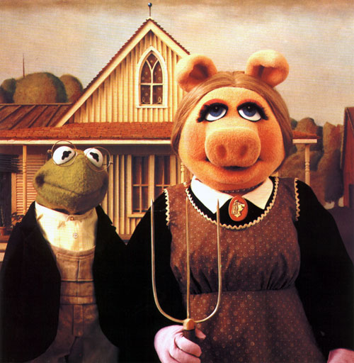
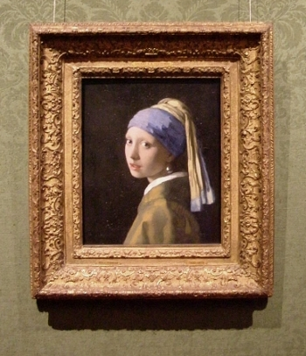
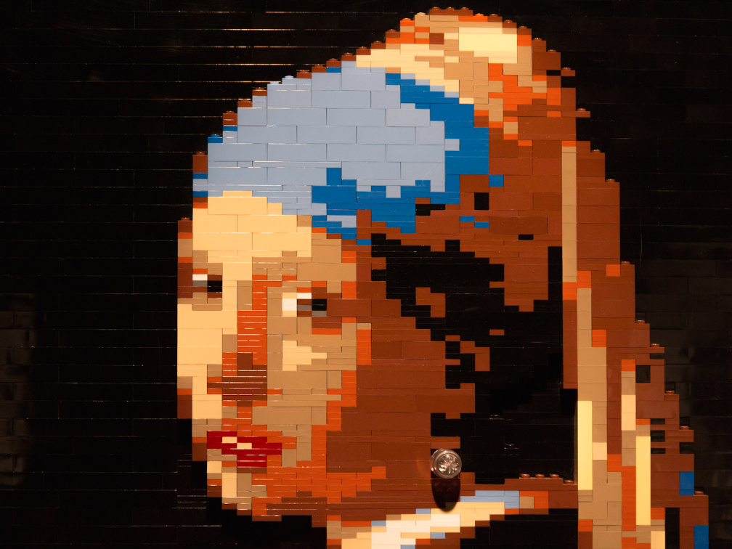
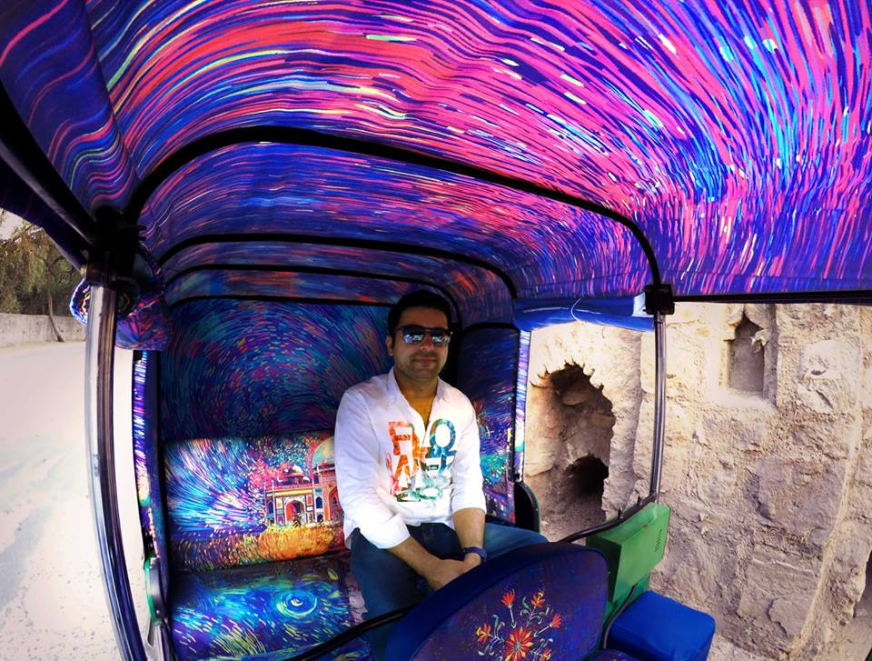
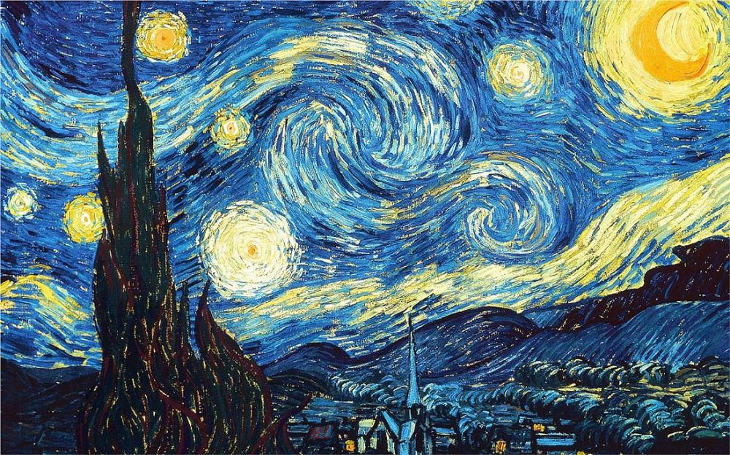
Replica vs. Inspiration
What is a replica?
a duplicate of an original artistic work.
How would you define inspiration?
something that makes someone want to do something or that gives someone an idea about what to do or create : a force or influence that inspires someone

Slide 8
Taiwanese Art Group – Starry Night
4 million water bottles were used
These artists used a famous painting to convey a message
Why is this artwork a replica, and not an inspiration piece?
Think about the kind of story you want your automaton to tell

Slide 9
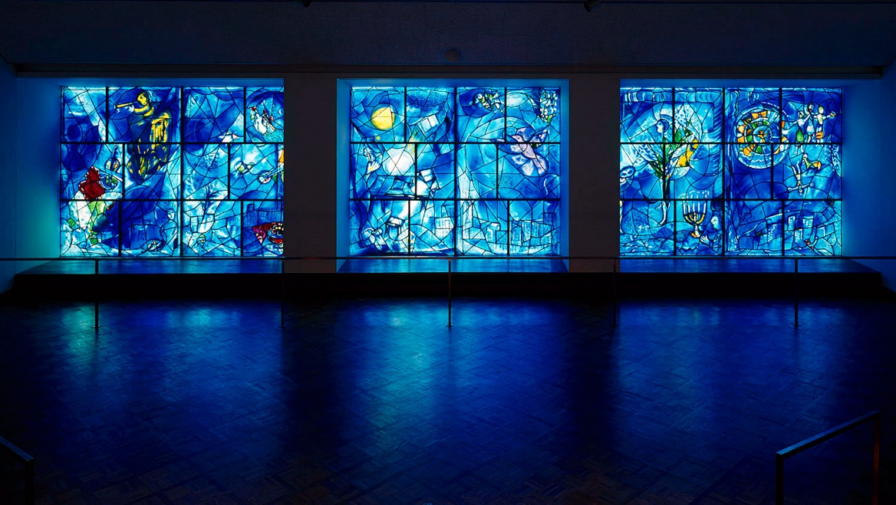
Lexie Lazear – inspired by Marc Chagall
Makeup Artist inspired by famous works of art
Uses her face as a canvas
Replica or Inspiration?

Slide 10
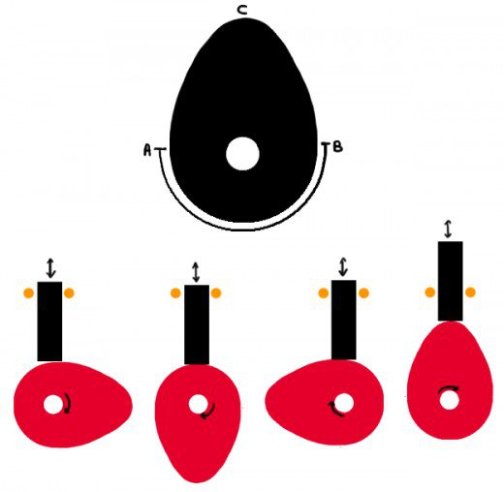
Today: How will we build our Automata?
First, we will Tinker with automata examples
We will follow a safety demonstration
We will create the frame for our automata
In a later lesson, we will create an up and down cam for our automatons

